Slide 1
Simon Says
By: Group 5

Slide 2






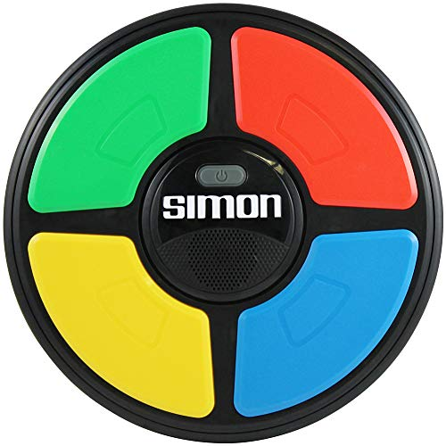






What is Simon Says?
Simon Says is a software version of an old handheld memory game
Simply listen to and watch the pattern that the computer plays, then play the same pattern back again
You get 3 tries to get it right or it's game over!

Slide 3





How do I play Simon Says?
You can use the keyboard keys (arrows, or WASD) or your mouse to click on the buttons. Watch and listen carefully to the pattern!
The goal of Simon is to beat your own “high score” - the more you can remember, the higher your score!
If you miss a note, the computer will remind you of the pattern by playing it again. If you miss three times, GAME OVER!. And the game resets.

Slide 4

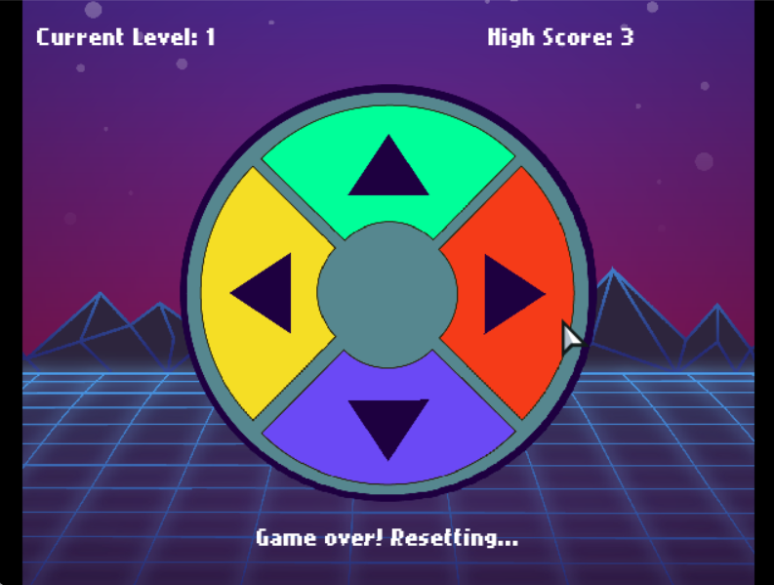
UI
User Interface design and layout
Making the User Interface
Declaring the images
Setting the Alpha
Placing the text and image

Slide 5



Music and sound effects
Sound effects and music are important in a video game because they help to create an immersive and engaging experience for the player and help the player navigate and interact with the game world.
Music can set the tone and mood of different parts of the game. Together, they can enhance the emotional impact of the game, create tension, and add to the overall enjoyment of the player's experience.

Slide 6

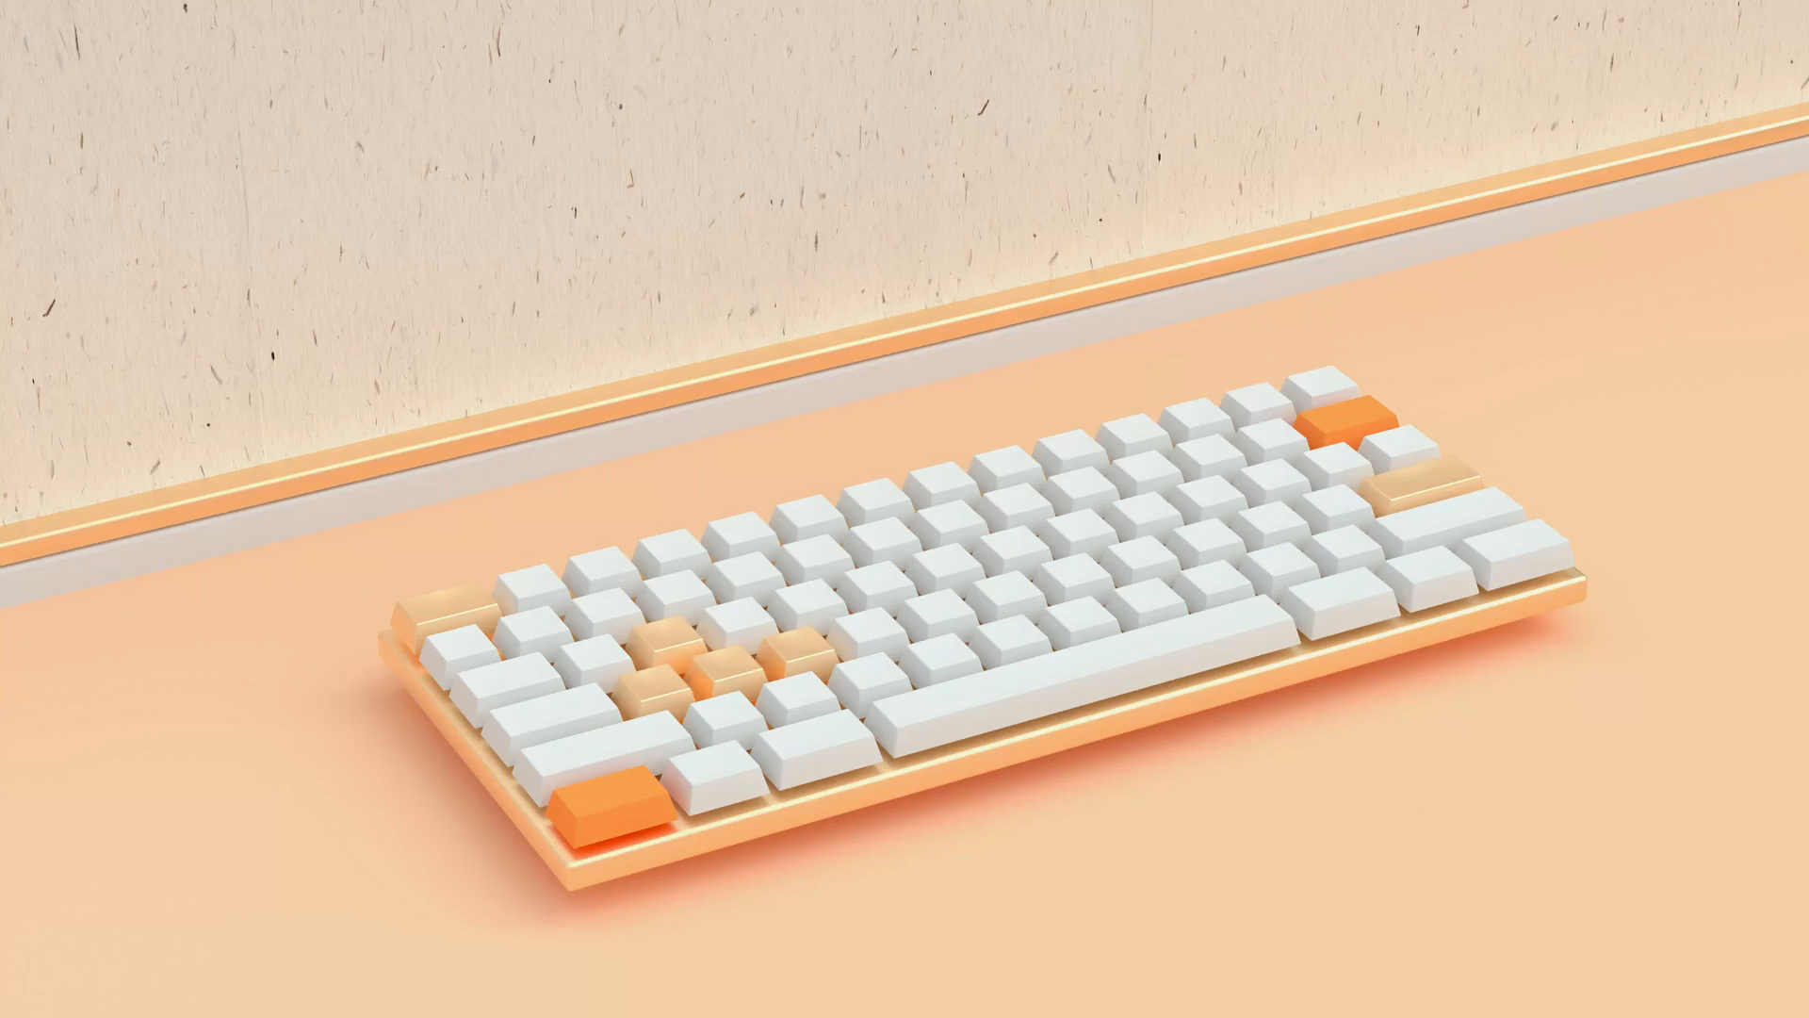

Input/Output keyboard and mouse inputs
Our game uses Multiple keys at once using anyjustpressed() method. This allows us to control the game using multiple keys at once with either WASD or arrow keys.
These methods take an Array of key names (as Strings) and return true if any of the given keys have the desired property.
Exactly the same logic we used for mouse inputs using justpressed() method and next we used built in overlaps() method which checks if the current position of the mouse overlaps the sprite. We then check if the mouse is pressed, by default this will refer to either a left click or touch.

Slide 7

Michael Stone: UI design and layout, group coordinator
Jaimin Dineshkumar Sojitra: IO - mouse and keyboard input
Aashish Umeshbhai Tank: Music, sound effects
Terry Smith: Game play
Junyu Tao: Documentation and presentation
Aravind Thiagarajan: Documentation and presentation

